Slide 1
Predictive value of repeated measures for graft and patient failure
Laura Niesse (15942619)
Tyenca de Graf (15688097)

Slide 2
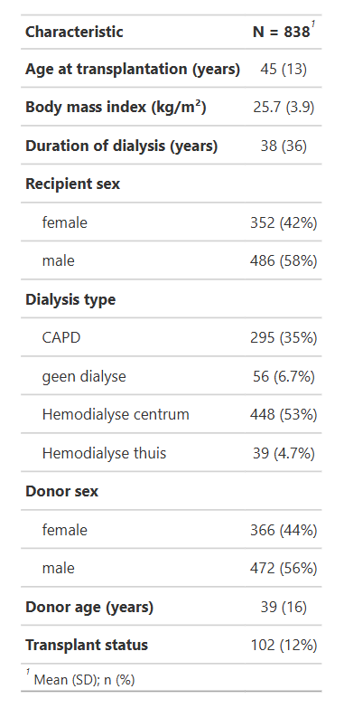
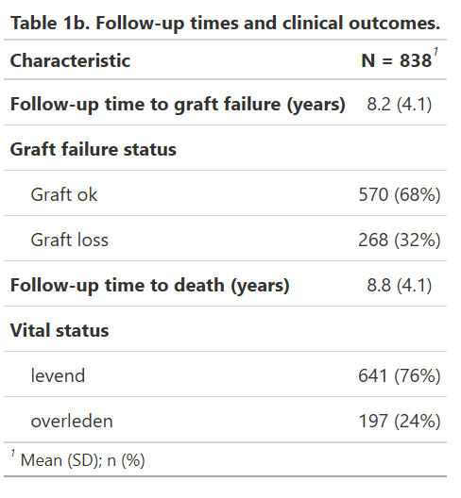
Baseline characteristics 'd'
Table 1a shows the baseline characteristics of the 838 kidney transplant recipients. The mean age at transplantation was 45 years (SD 13) and the mean BMI was 25.7 kg/m^2 (SD 3.9). Paitents had undergone dialysis for a median of 38 months before receiving the transplant.
Most recipients were male (58%) and the majority received hemodialysis (53%) prior to transplantation. Peritoneal dialysis (CAPD) was used in 35% of patients and an even smaller proportion underwent home hemodialysis (4.7%). Regarding donor characteristics, 56% of kidneys were obtained from male donors with a mean donor age of 39 years (SD 16).
Most transplantations were first transplants (88%) while 12% of patients received a retransplant.
Table 1b summarisis the follow-up and event outcomes. During a mean follow-up time of 8.2 years (SD 4.1) for graft failure, 32% of transplants failed.
Table 1a. Baseline characteristics of kidney transplant patients
Table 1b – Follow up times and clinical outcomes

Slide 3
Baseline characteristics 'd'
Table 1c shows the continuous baseline characteristics with extended information on the mean, standard devation, median, IQR, minimum and maximum values.
Variable | N | Mean | SD | Median | IQR | Min | Max
age_at_tx | 838 | 45.15 | 13.39 | 46.55 | 21.51 | 14.41 | 77.96
bmi | 838 | 25.66 | 3.92 | 25.37 | 4.88 | 15.82 | 46.61
agedon | 838 | 38.72 | 15.73 | 40.0 | 27.0 | 0.0 | 71.0
duur_dia | 838 | 37.9 | 36.02 | 29.0 | 35.0 | 0.0 | 398.0
gfr3 | 838 | 53.41 | 18.34 | 52.0 | 25.0 | 7.0 | 115.0
screat3 | 838 | 152.23 | 55.76 | 141.0 | 59.0 | 68.0 | 661.0
map3 | 838 | 108.07 | 12.26 | 107.0 | 16.75 | 73.0 | 167.0
Table 1c - Continuous Baseline Variables

Slide 4
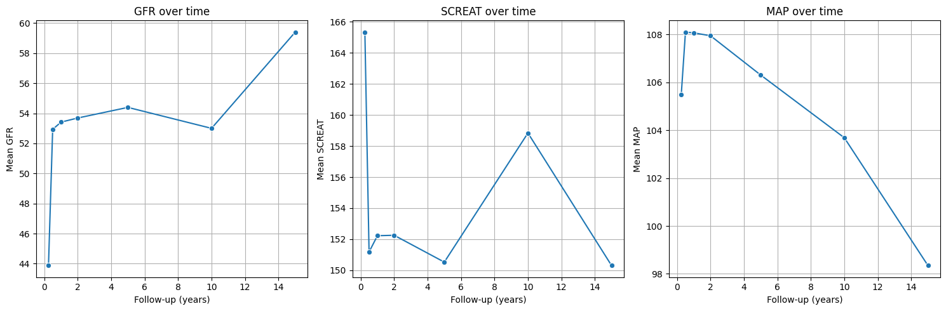
Data description Repeated measures
Every patient has exactly 7 measurements (based on the years variable: 0.25, 0.5, 1, 2, 5, 10, 15 years). The early years show a low rate of missing values, the later years have a high rate of missng values. This is expected and most likely due to graft failure, death, censoring or end of follow-up. Figure 1 shows the mean value of each biomarker at the scheduled follow-up visits. Serum creatinine (creat) and mid arterial pressure (map) show a rapid decline in later years as expected. However, glomerular filtration rate (gfr) rises after transplantation, stabilizes and then rises again. This indicates survivor bias, meaning patients with bad GFR results are not in the dataset anymore and only the patients with proper functioning kidneys are left. To produce more accurate predictions, we will impute the missing data in the next step.
Years | gfr (%) | creat (%) | map (%)
0.25 | 6.92 | 0.00 | 0.00
0.50 | 10.26 | 0.12 | 0.12
1.00 | 0.00 | 0.00 | 0.00
2.00 | 16.59 | 7.04 | 6.09
5.00 | 34.84 | 35.08 | 31.15
10.00 | 76.13 | 77.92 | 74.70
15.00 | 94.87 | 96.90 | 94.51
Figure 1 - Mean Biomarker Trend Plots over Time
Figure 2 - Missingness by follow-up time (%)

Slide 5
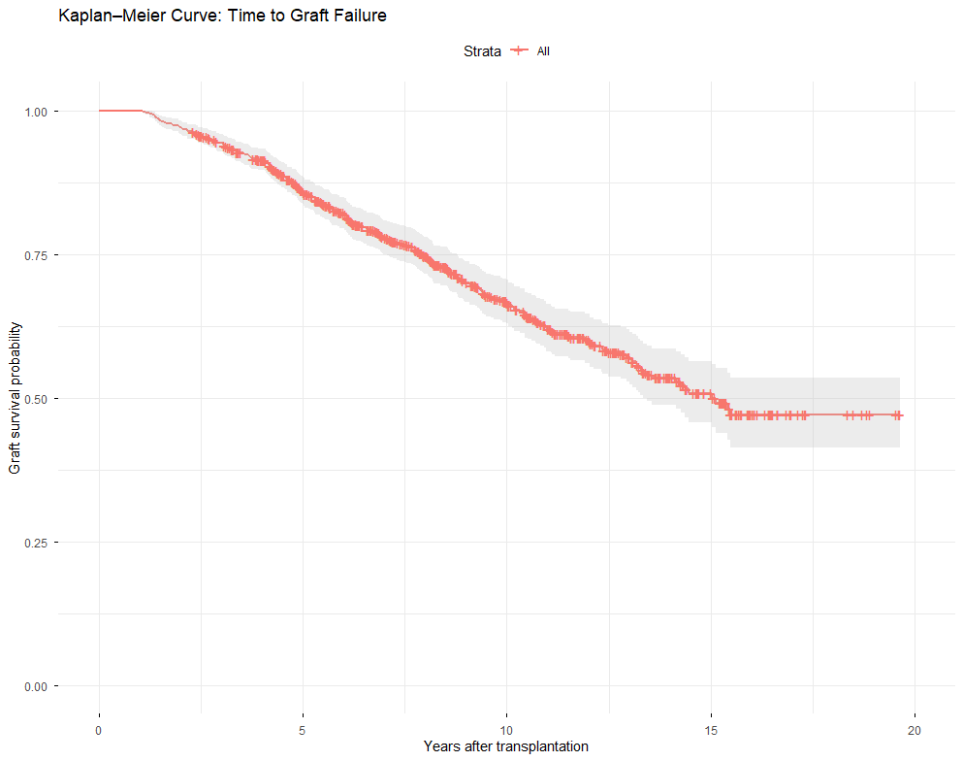
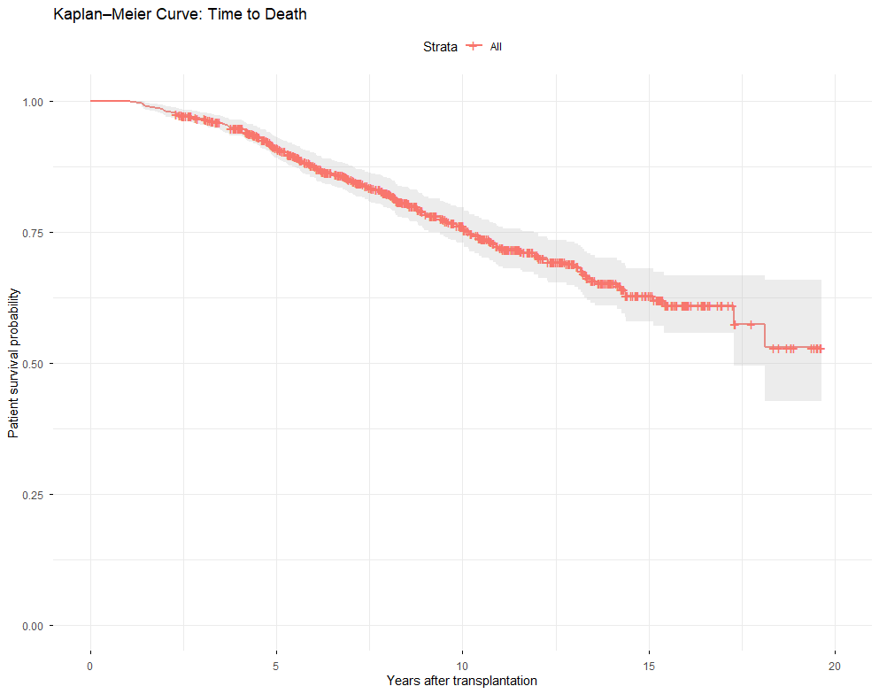
Data description
The KM curve for graft failure shows a gradual decline in graft survival over the years, with the majority of graft losses occurring within the first 5–10 years post-transplantation. The widening confidence intervals in later years suggest high censoring, fewer events and reduced precision. This pattern supports the need for time-dependent modelling, as graft function changes meaningfully over time and contributes to graft loss.
The KM curve for time to death demonstrates a slower decline compared to graft survival, indicating that many patients remain alive after losing their graft. Mortality increases more gradually over time, with wider uncertainty in later years. This pattern highlights that graft failure and death follow distinct trajectories, justifying the separate Cox models for each endpoint.
Figure 3 - Kaplan Meier plot for time-to-graft failure
Figure 4 - Kaplan Meier plot for time-to-death

Slide 6
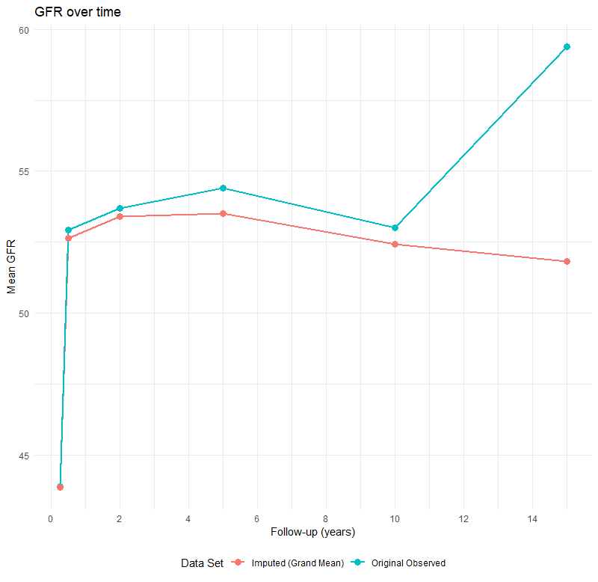
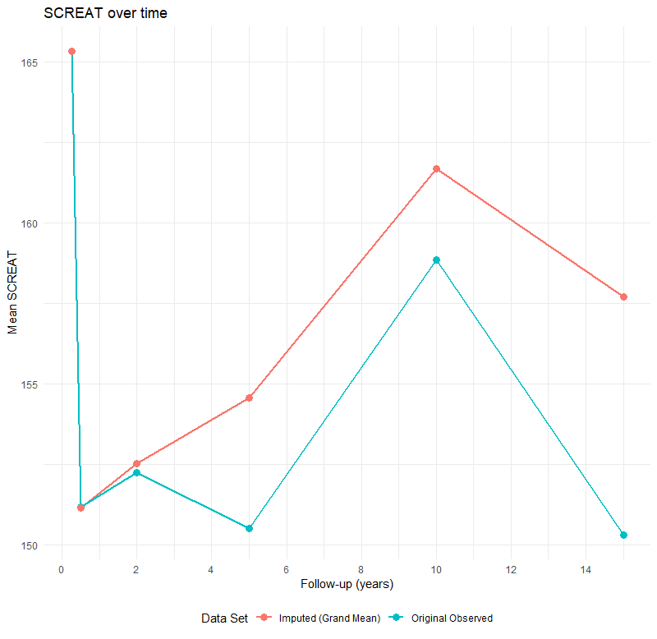
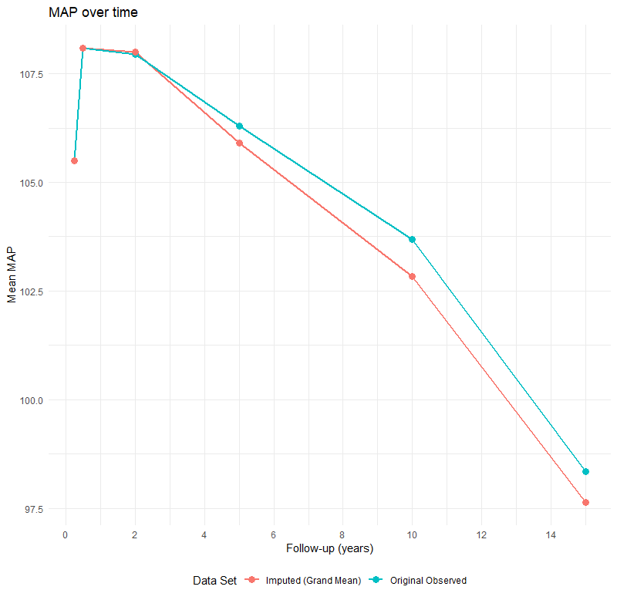
Missing data
Missing data in the covariates were analysed and imputed using the MICE method, restricted to the 21 longitudinal variables (gfr1–7, screat1–7, map1–7). The baseline variables and the outcome were included to help predict the missing biomarker values. For this analysis, 10 imputed datasets were generated, each obtained after 10 internal iterations. Following imputation, the Cox model with time-dependent covariates was separately fit on each imputed dataset. We used Rubin's Rule to pool the results and produce a final prediction. This approach reduces bias and increases efficiency. As seen in Figure 5 the imputed values better match the expected patterns of the data. We now turn to the interpretation of the results.
Figure 5 - Cox model with time-dependent covariates vs original data

Slide 7
Cox regression Baseline covariates
Table 2 presents the pooled hazard ratios from the Baseline covariates cox model for graft failure. Several baseline variables were significantly associated with the risk of graft failure, meaning where HR > 1 and P < 0.05. Age_at_tx was a strong predictor (HR = 1.03), indicating that older recipients had a higher risk of graft loss. Male patients also had an increased hazard (HR = 1.32).
Among dialysis, hemodialysis in a center (HR = 1.42) was associated with a significantly higher risk of graft failure compared with the reference group (HR = 1.420). Additionally, donor age showed a small but significant effect (HR = 1.01), meaning that kidneys from older donors had a slightly higher risk of failure.
Other baseline predictors were not significantly associated with graft failure. Overall, the baseline Cox model identifies several risk factors present at transplantation, but it does not provide the full information yet. We will fit Cox regression again, this time with the time dependent covariates included.
Variable | HR | Lower 95% CI | Upper 95% CI | p-value
age_at_tx | 1.0311 | 1.0205 | 1.0418 | 6.23×10⁻⁹
sex_pat: male | 1.3226 | 1.0324 | 1.6945 | 0.02696
bmi | 1.0008 | 0.9676 | 1.0352 | 0.96276
type_dia: geen dialyse | 0.9127 | 0.5154 | 1.6163 | 0.75401
type_dia: HD centrum | 1.4203 | 1.0652 | 1.8937 | 0.01682
type_dia: HD thuis | 1.3479 | 0.7831 | 2.3200 | 0.28118
duur_dia | 1.0009 | 0.9975 | 1.0043 | 0.61448
sexdon: male | 1.0013 | 0.7828 | 1.2809 | 0.99156
agedon | 1.0142 | 1.0062 | 1.0222 | 0.000446
retrans | 1.0046 | 0.6944 | 1.4533 | 0.98057
Table 2 – Cox regression analysis with baseline covariates

Slide 8
Cox regression Time dependent covariates
Variable | HR | Lower 95% CI | Upper 95% CI | p-value
age_at_tx | 1.0368 | 1.0252 | 1.0486 | 2.84×10⁻¹⁰
sex_pat: male | 1.0682 | 0.8061 | 1.4155 | 0.6462
bmi | 1.0030 | 0.9673 | 1.0400 | 0.8715
type_dia: geen dialyse | 0.8512 | 0.4772 | 1.5185 | 0.5855
type_dia: HD centrum | 1.4946 | 1.1157 | 2.0020 | 0.00706
type_dia: HD thuis | 1.3120 | 0.7592 | 2.2672 | 0.3306
duur_dia | 1.0008 | 0.9975 | 1.0042 | 0.6231
sexdon: male | 1.0810 | 0.8380 | 1.3944 | 0.5488
agedon | 0.9972 | 0.9885 | 1.0061 | 0.5407
retrans | 1.0829 | 0.7470 | 1.5698 | 0.6741
gfr | 0.9794 | 0.9638 | 0.9953 | 0.0111
screat | 1.0069 | 1.0038 | 1.0101 | 1.55×10⁻⁵
map | 1.0102 | 1.0011 | 1.0194 | 0.0273
Table 3 presents the pooled hazard ratios from the t Cox model for graft failure with time-dependent gft, screat (serum creatinine) and map included. Among the dynamic biomarkers, all 3 were statistically significant predictors of graft failure.
The results show that screat (HR = 1.004) and map (HR = 1.004) are associated with a higher hazard of graft loss, indicating that increases in creatinine and higher blood pressure increase the hazard of graft loss. GFR(t) was protective (HR = 0.979), meaning that higher contemporaneous GFR reduces the risk of graft failure.
Notably, several baseline predictors that were significant in the baseline model became weaker and lost significance in the time-dependent model. Age_at_tx and haemodialysis in a centre remained significant baseline predictors after adjustment for biomarker trajectories.
Table 3 – Cox regression analysis including time dependent covariates

Slide 9
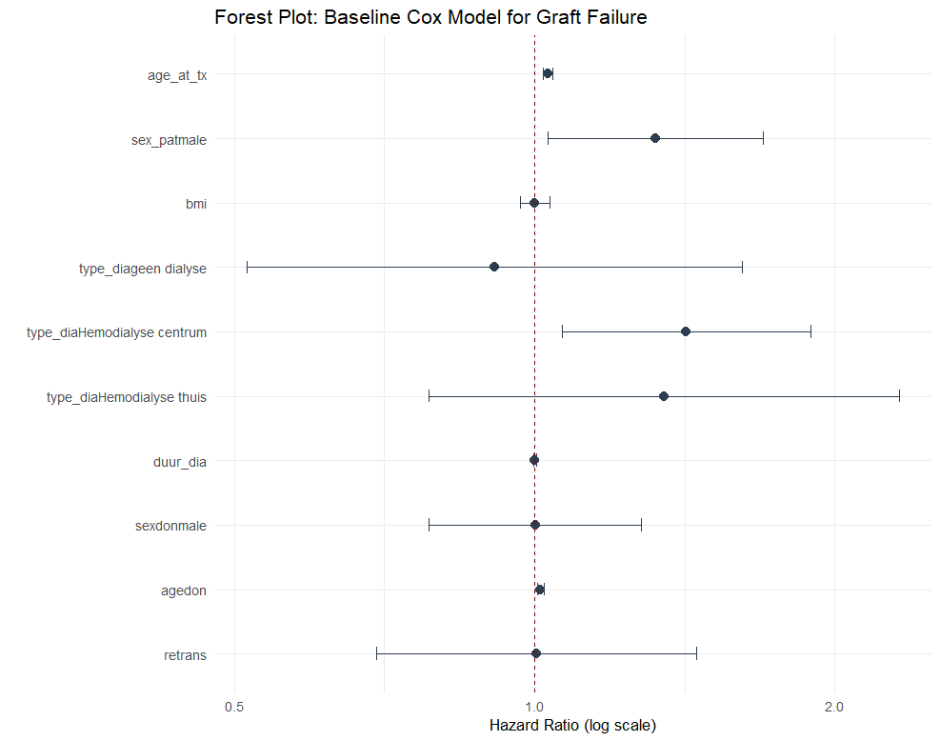
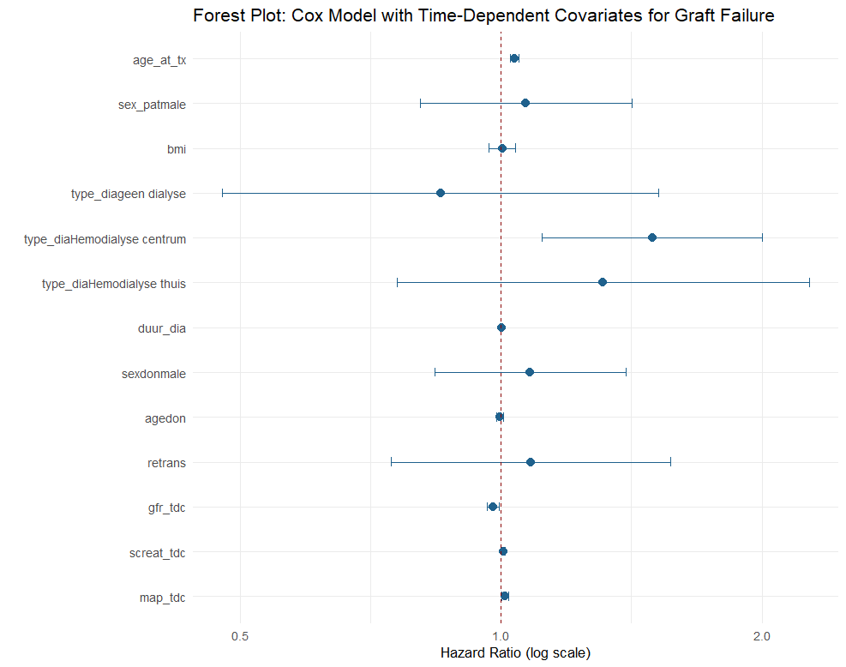
Cox regression
Figure 6 – Baseline covariates Cox model (with CI bands)
Figure 7 – Time dependent covariates Cox model (with CI bands)

Slide 10
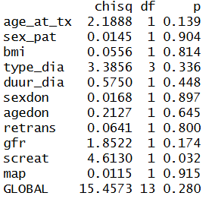
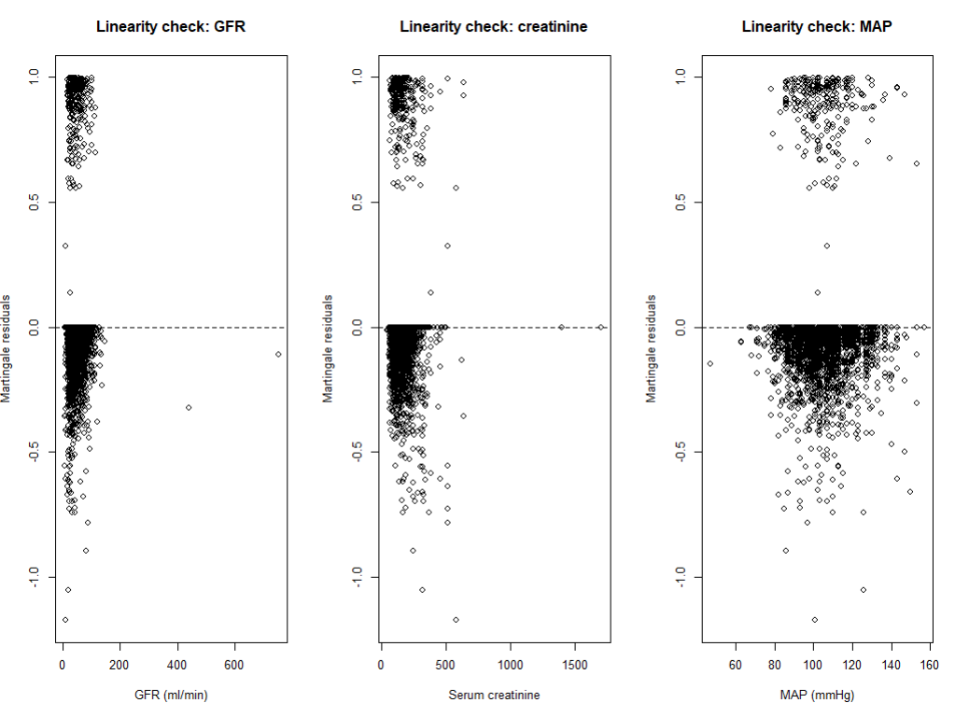
Assumptions Cox model
Proportional Hazards assumption (PH): Assumption of the time-dependent Cox model was evaluated using Schoenfield residuals. For almost all covariates, there were no violations of the PH assumptions (p > 0.05). Only serum creatinine showed a small deviation (p=0.032), suggesting that its effect may vary slightly over time. However, the global test was not significant. Therefore we conclude that there are no violations of the PH assumption. See Table 4.
2) Check start – stop. We also checked if tstart is always before tstop for all rows. This turned out to be true.
3) Martingale plots: in the time-dependent Cox model, GFR creatinine and MAP were included as continuous linear predictors. The linearity was assessed using Martingale residuals. The plots showed no evidence of nonlinearity. This supports the assumed linear assumption. See figure 8.
Table 4 - Time dependent covariates Cox model (with CI bands)
Figure 8 - Time dependent covariates Cox model (with CI bands)​

Slide 11
Competing risks
By attemptig to plot the Cumulative incidence curves (CIF), we discovered that there is no competing-risk for graft failure. Meaning, no patients died prior to graft failure. Therefore, death did not act as a competing event for graft loss, and the CIF includes only graft failure which confirms this statement. Because no competing risk occurred, standard cause-specific Cox regression is appropriate for this endpoint and we can move on to our joint LME model.

Slide 12



Create LME models
First we fitted 3 LME models for each biomarker: a random intercept model, random Intercept + random slope model and random Intercept + random spline model. Model performance was compared using the Akaike Information Criterion (AIC), where lower AIC values indicates a better fitting model. The results are summarised below. Based on the AIC comparison, the optimal LME model for each biomarker was:
GFR: random Intercept model
Creat: random Intercept + random Spline model
Map: random Intercept + random Spline model
Figure 9 - GFR
Figure 10 - CREAT
Figure 11 - MAP

Slide 13
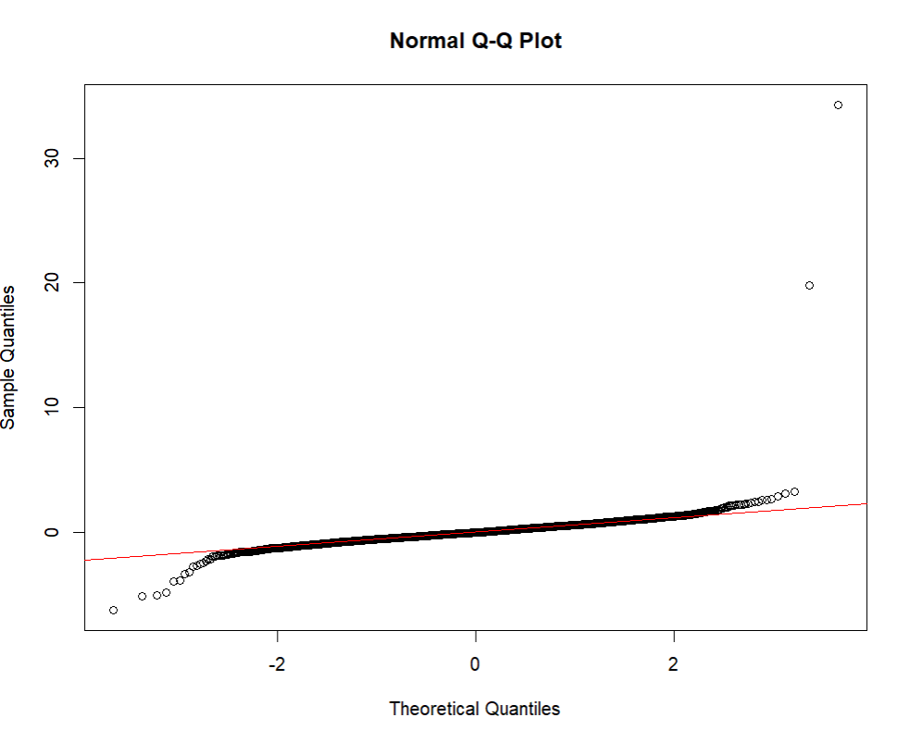
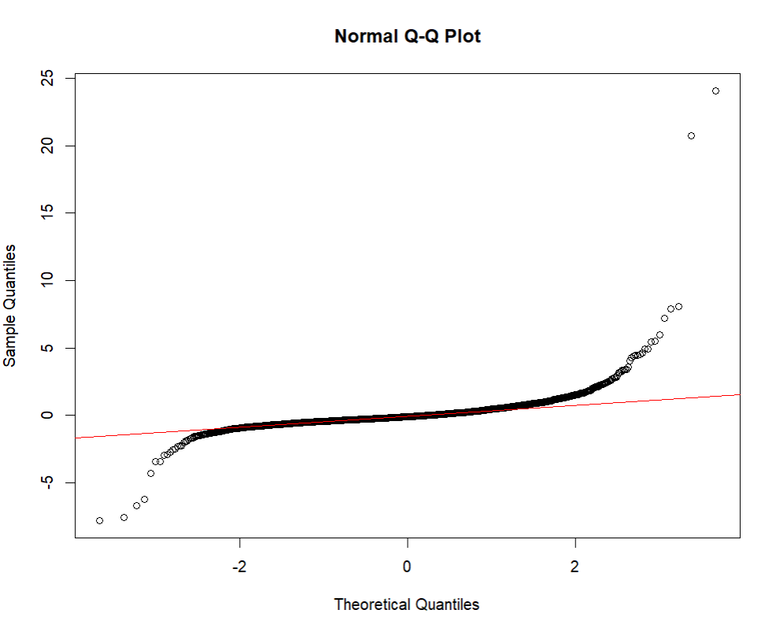
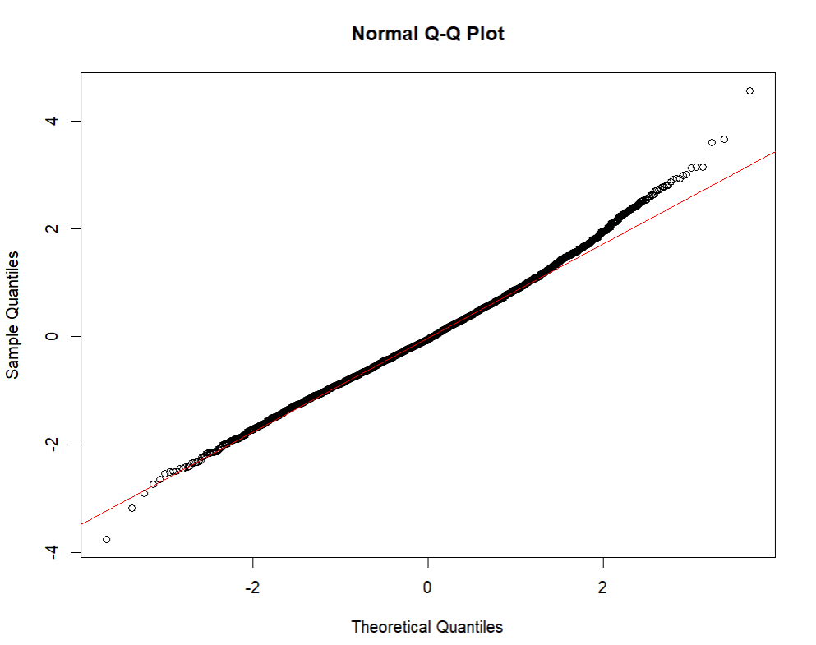
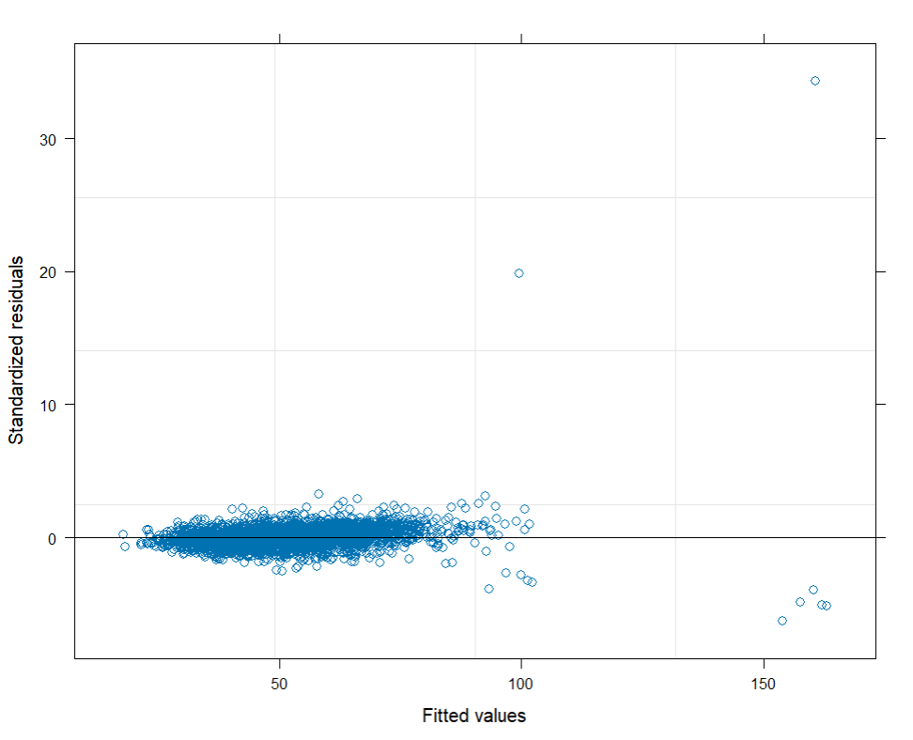
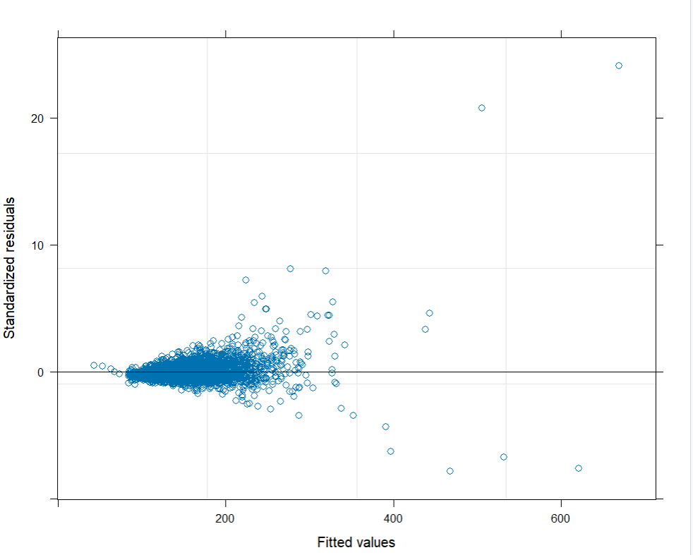
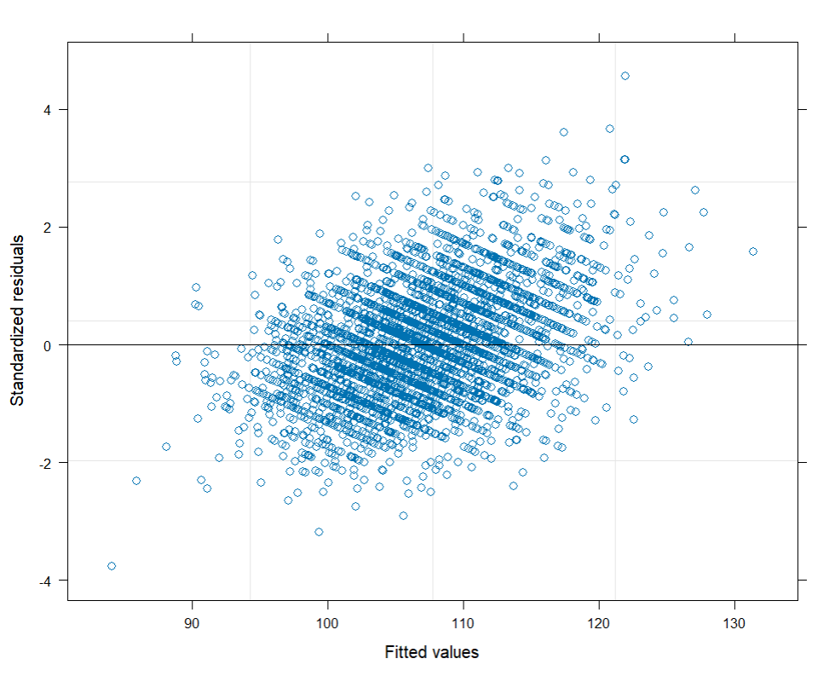
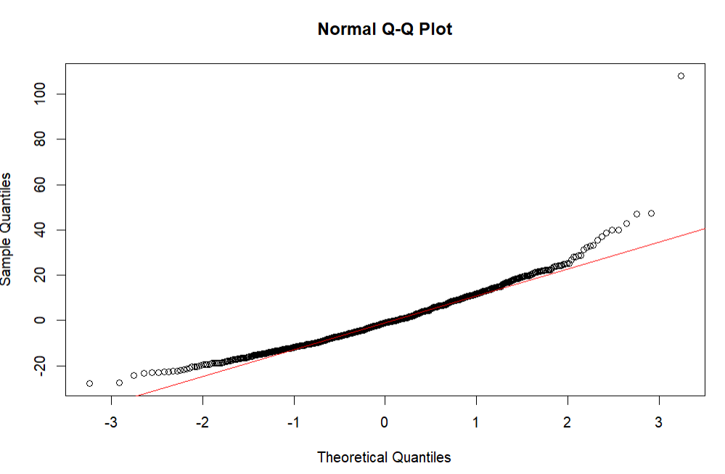
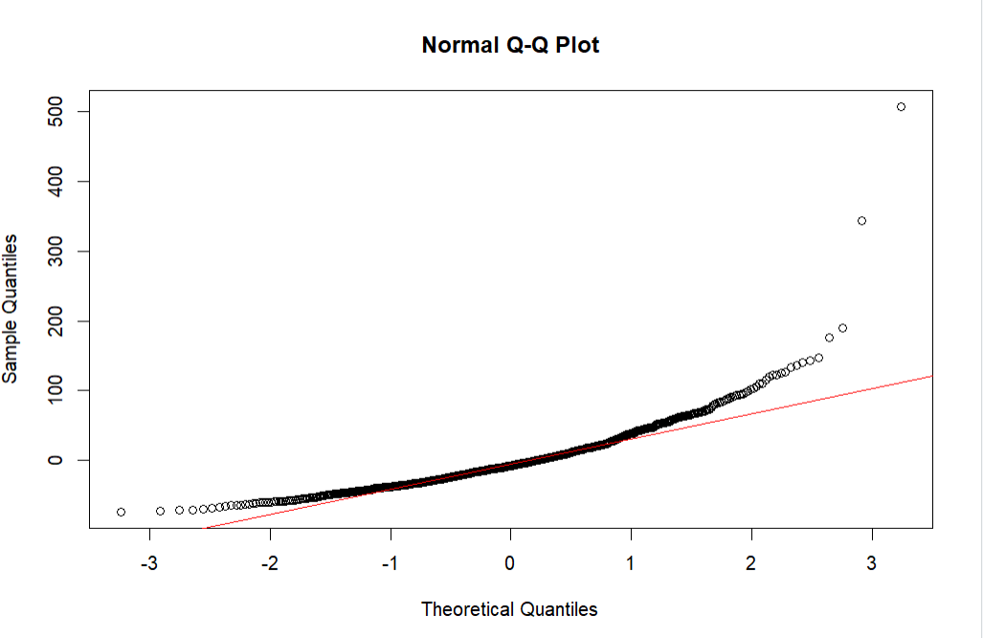
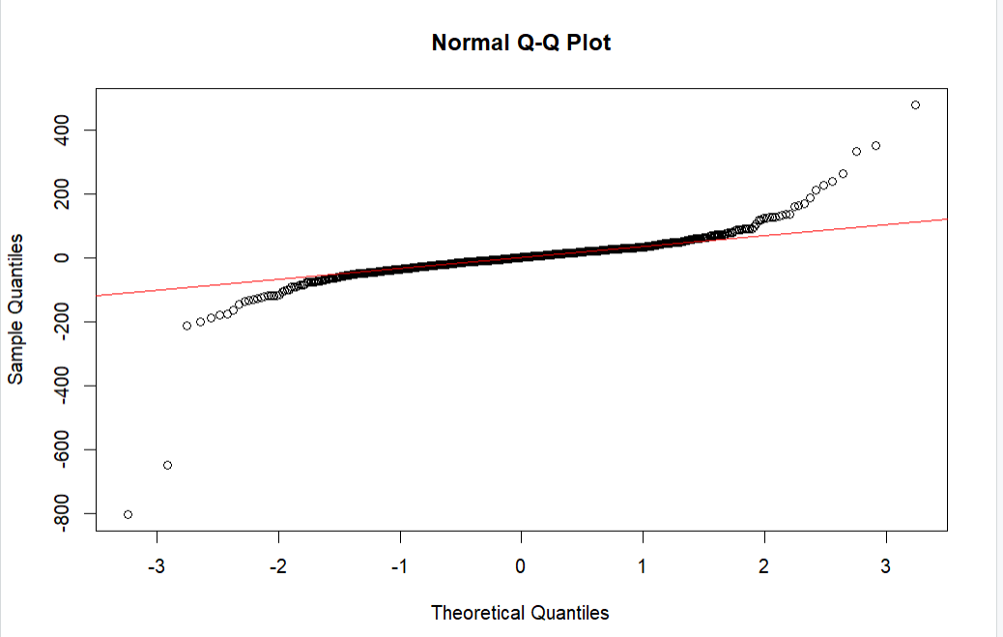
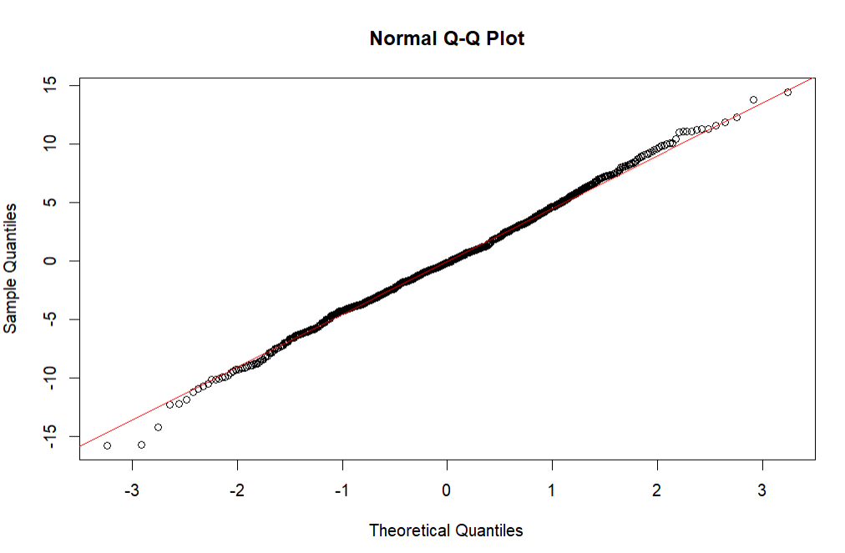
Assumptions LME models
Residual normality: Residual diagnostics for the three LME models (GFR, creatinine and MAP) showed that the normalized residuals generally centered around zero. The normal QQ plts also showed normality with only small deviations at the tails. Therefore, the assumption was met.
Homoscedasticity was evaluated using residuals vs fitted plots for all three longitudinal mixed-effects models. In each model, the residuals displayed a contstant variance across the range of fitted values. Overall, some outliers were present and a slight diagonal shape can be seen for MAP. Despite this minor deviation, the assumption of homoscedasticity was met.
Normality of random effects was checked using QQ plots for the random intercepts and spline terms of the GFR, creatinine and MAP LME models. Across biomarkers, the majority of the dots followed the line (normal distribution). There were some mild deviations in the tails. Overall, the assumption was met. For convenience, we added only 4 plots.
Figure 12 - Residual normality Q-Q plots
Figure 13 - residuals vs fitted plots
Figure 14 - residuals vs fitted plots

Slide 14
Joint Cox–LME model GFR
We fitted a joint model combining the linear mixed-effects model for longitudinal GFR with a Weibull survival model for time to graft failure. The model included 3,858 GFR measurements from 838 patients (with 268 graft failures).
Longitudinal: GFR at 3 months post-transplant was approximately 46 ml/min. The spline model showed a nonlinear GFR with a moderate early development followed by a gradual decline. There was considerable between-patient variation (SD = 14.5 ml/min).
Survival: Older age (HR 1.03 per year), male sex (HR 1.60) and haemodialysis in a centre (HR 1.37) increased the risk of graft failure. Other baseline characteristics were not significantly associated with the event.
The association parameter was significantly negative (alpha = -0.0516, p< 0.001), corresponding to a hazard ratio of 0.95 per 1 ml/min higher current GFR. This means that better graft function is very protective. This means that a 10 ml/min higher GFR reduces the hazard of graft failure by 40%.
The joint model shows that the trajectory of GFR over time is closely linked to graft survival and that current GFR is a strong dynamic predictor of graft failure.

Slide 15
Joint Cox–LME model CREAT
Another joint model was fitted linking a linear mixed-effects model for longitudinal creatinine with a weibull survival model for graft failure. The model included 4,047 creatinine measurements from 838 patients (with 268 graft failures).
Longitudinal part: Baseline creatinine at 3 months was approximately 162 millimol/L, with substantial between patient variation (SD=50). The spline term for the later follow-up period was significant, indicating a nonlinear trajectory over time. The predicted curves show moderate fluctuations and a gradual increase over the years, consistent with renal function decline.
The recipient age (HR 1.05 per year, p<0.01) and haemodialysis in a centre (HR 1.54, p= 0.0047) were associated with higher graft-failure risk. Other baseline variables were not significant.
The association parameter was alpha = +0.0129 with p< 0.001. The HR per 1 micromol/L increase = 1.013. Therefore, higher current creatinine levels are strongly associated with an increased hazard of graft failure. We conclude that creatinine is also a strong predictor of graft failure: as creatinine rises, the risk of graft loss increases.

Slide 16
Joint Cox–LME model MAP
Last, a joint model was fitted linking longitudinal MAP to the hazard of graft failure. The model included 4135 MAP measurements from 838 patients (268 graft failures). Convergence was achieved.
Longitudinal: baseline MAP was approximately 106 mmHg at the first visit (3 months). The time showed a small but statistically significant decline later in follow-up (spline df=3, p<0.001). There was moderate between-patient variability in MAP levels (random intercept SD = 6 mmHg).
Survival: Higher recipient age (HR 1.03 per year, p<0.0001), haemodialysis in a centre ( HR 1.41, p= 0.028 and older donor ( HR 1.02 per year, p=0.0001) were associated with increased graft-failure risk. Other baseline characteristics were not significant.
The association parameter was alpha = +0.0786 with a p-value < 0.0001. The HR per 1 mm Hg increase = 1.08. Therefore, higher current MAP value is strongly associated with increased risk of graft failure.
We conclude that also MAP is a significant predictor of graft failure. If MAP rises over time, the risk of graft loss increases. The effect size is stronger than for creatinine and GFR per unit.

Slide 17
Assumptions Joint Cox-LME
We evaluated whether the assumptions of the joint Cox-LME models were met. The three longitudinal models satisfied the mixed-model requirements. The survival component met the PH assumption. All joint models converged without any problems. The association parameters between each biomarker to the risk of graft failure were stable and significant.
Next step is the dynamic prediction. Afterwards we will check these results.

Slide 18
Comparison of Time-dependent Cox vs Joint models
Predictor | TD-Cox HR | Joint GFR HR | Joint Creat HR | Joint MAP HR
Age_at_tx | 1.0368 | 1.031 | 1.045 | 1.029
Male sex | 1.068 (NS) | 1.60 | NS | 1.24 (NS)
BMI | 1.003 (NS) | NS | NS | NS
Dialysis: HD centre | 1.49 | 1.37 | 1.54 | 1.41
Dialysis: HD home | 1.31 (NS) | NS | NS | NS
Dialysis: none | 0.85 (NS) | NS | NS | NS
Dialysis duration | NS | NS | NS | NS
Male donor | NS | NS | NS | NS
Donor age | NS | NS | NS | 1.02
Retransplant | NS | NS | NS | NS
GFR | 0.979 | 0.95 | - | -
Creatinine | 1.0069 | - | 1.013 | -
MAP | 1.0102 | - | - | 1.08
We compared the results of the time-dependent Cox models and the Joint Cox models. Table 5 summarises the estimated effects of the three biomarkers on the risk of graft failure, comparing the time-dependent Cox model with the three separate joint Cox-LME models. Overall, the direction of the effects was highly consistent across all variables. For example, a higher GFR was associated with a lower risk of graft failure, whereas higher creatinine and MAP were associated with increased risk.
In the time-dependent Cox model, all three biomarkers were statistically signficiant predictors. Higher GFR showed a moderate protective effect (HR 0.979), while both creatinine (HR 1.007) and MAP (HR 1.010) showed small but significant increases in hazard. Other baseline characteristics that were significant were recipient age and dialysis in a centre.
The joint models produced effects in the same direction but the effects were greater. For example, the association between GFR and graft failure was considerably stronger in the joint model (HR = 0.95 per ml/min) than in the Cox model. This is also true for creatinine and MAP, they have larger hazard ratios.
Across all models, only a subset of baseline characteristics remained significant. Recipient age and haemodialysis in a centre were consistently associated with a higher hazard, whereas BMI, donor sexe, retransplantation status and dialysis duration were non-significant in nearly all models.
Table 5 - Comparison of Time-dependent Cox vs Joint models

Slide 19
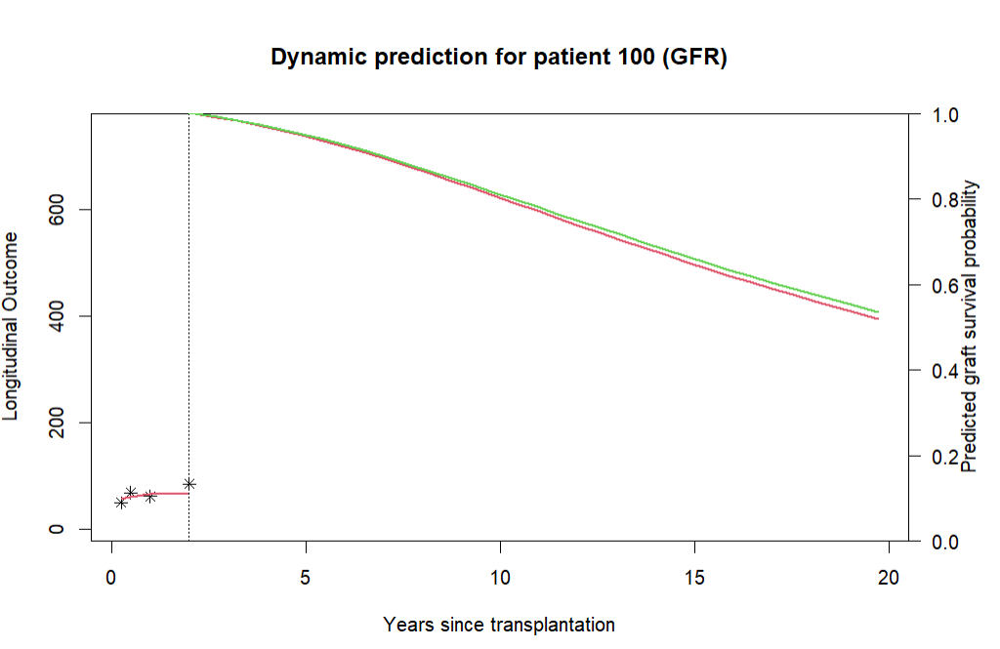
Dynamic prediction GFR: patient 100
Using the fitted joint model we performed a dynamic, patient-specific prediction of graft survival. We randomly chose patient ID 100 to display. The graph can be seen in Figure 15. On the left we see the GFR measurements (stars), with the red line as an individual trajectory. The vertical line is the last GFR measurement. This line is followed by our prediction line. We see that at the start, the predicted survival of the graft is 1. After 5 years, little above 80%. At 10 years after transplantation there is a 70% estimated survival probability and at 20 years around 55%. The results are somewhat above average, yet clinically plausible (to our knowledge) and suggest a good prognosis.
Figure 15 – dynamic patient-specific prediction (GFR)

Slide 20
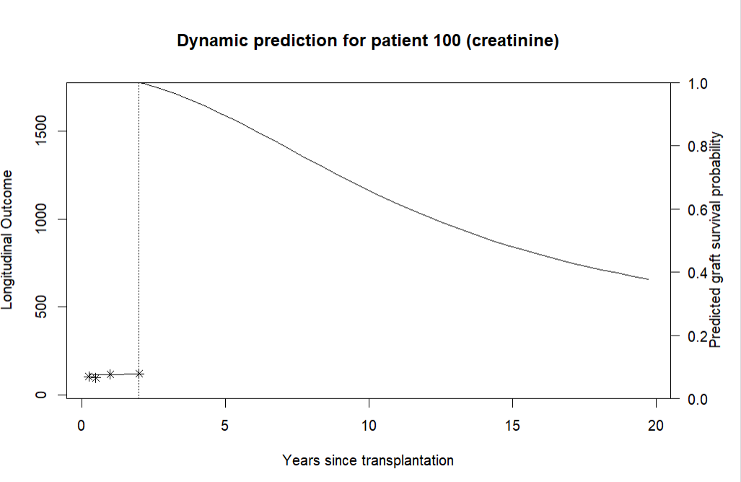
Dynamic prediction CREAT: patient 100
Using the fitted joint model with creatinine as a marker, we performed also a dynamic prediction of the graft survival for patient with ID 100 (Figure 16). At landmarktime, the predicted graft survival probability is 1.0. After 5 years the estimated survival probability is still around 80% but it decreases to 60% at 10 years and about 40% at 20 years after transplantation. Because higher creatinine values are associated with a higher risk of graft failure, this prediction suggests a somewhat less favourable prognosis than the GFR. However, GFR is a better predictor for kidney failure.
Figure 16 – dynamic patient-specific prediction (CREAT)

Slide 21
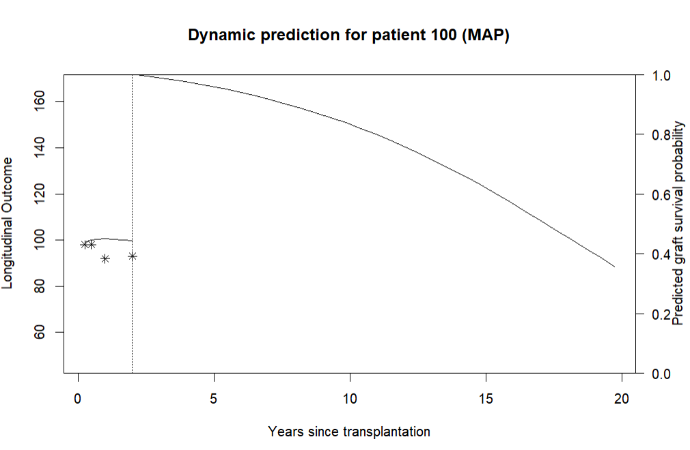
Dynamic prediction MAP: patient 100
Using the joint model with MAP as biomarker, we generated a dynamic prediction of graft survival for patient ID 100 (figure 17). At landmark time, the predicted survival probability starts at 1. Five years after transplantation, the estimated survival is slightly above 80%. At 10 years, the probability declines to around 65% and by 20 years it reaches 45%. Because higher MAP values are associated with incresed graft-failure risk, the prediction declines more steeply over time compared with GFR. However, MAP does not measure kidney function (compared to GFR and creatinine), it is a measure of blood pressure.
Figure 17 – dynamic patient-specific prediction (MAP)

Slide 22
Conclusion
For this assignment we compared standard Cox regression with time-dependent covariates to joint Cox-LME models for predicting graft failure after kidney transplantation. Although both approaches found GFR, creatinine and MAP as important predictors, the joint models provided a more complete picture of how the biomarkers change over time and how this affects patient's risk.
By using the joint models, we were able to produce dynamic survival predictions. Where each model predicted a specific patient's survival per new biomarker. This led to a continuously updated patient prediction.
Overall, we conclude that while the Cox regression model provides a useful basis insight, the joint Cox-LME models provided a more comprehensive framework on the risk of graft failure.

